Slide 1
ECE2006-DIGITAL SIGNAL PROCESSING
DATE: 14/10/2020
JYOTIKA KATYAL-18BEC1265
ARJUN BATHLA-18BEC1236

Slide 2
MEASURING SIZE OF OBJECTS IN AN IMAGE
PROGRAMMING LANGUAGE:
PYTHON
FILTER USED: GAUSSIAN FILTER

Slide 3
ALGORITHM USED :
CONVERT IMAGE TO GRAYSCALE
SMOOTH USING GAUSSIAN FILTER
EDGE DETECTION
FIND CONTOURS
COMPUTE ROTATED BOUNDED BOX OF IMAGE
COMPUTE MIDPOINTS OF BOUNDED BOX EDGES
FIND PPI RATIO FROM REFERENCE IMAGE
DIVIDE MID-POINT DISTANCES BY PPI

Slide 4
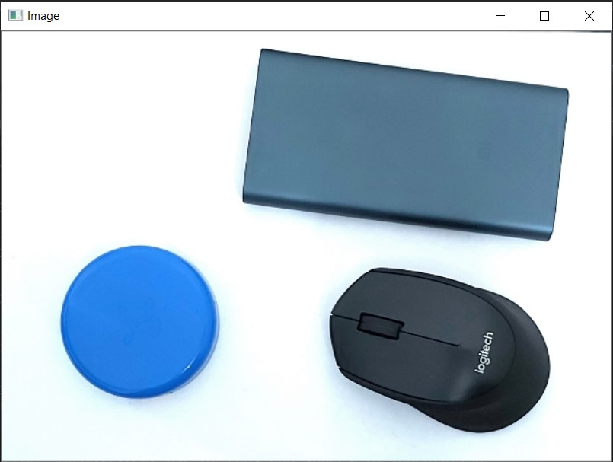
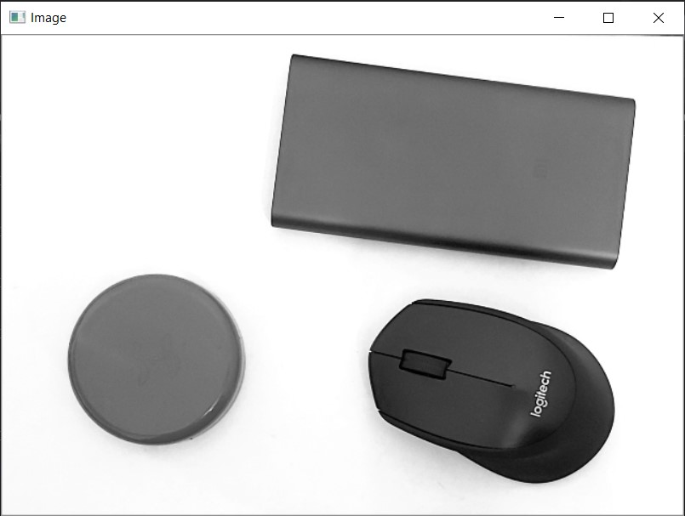
EXPLANATION OF CODE:
def midpoint(ptA, ptB):
return ((ptA[0] + ptB[0]) * 0.5, (ptA[1] + ptB[1]) * 0.5)
This function is used to calculate the mid point of the image.
gray = cv2.cvtColor(image, cv2.COLOR_BGR2GRAY)
This command converts the image’s colour-space to grayscale.

Slide 5

EXPLANATION OF CODE:
gray = cv2.GaussianBlur(gray, (7, 7), 0)
In this command, a Gaussian kernel is used. In Gaussian Blur operation, the image is convolved with a Gaussian filter instead of the box filter. The Gaussian filter is a low-pass filter that removes the high-frequency components. In terms of image processing, any sharp edges in images are smoothed while minimizing too much blurring. We specify the width and height of the kernel which should be positive and odd. Gaussian filtering is highly effective in removing Gaussian noise from the image.

Slide 6


MATHEMATICAL EQUATIONS OF THE FILTER
The formula of a Gaussian function in one dimension is
In two dimension
where x is the distance from the origin in the horizontal axis, y is the distance from the origin in the vertical axis, and σ is the standard deviation of the Gaussian distribution. When applied in two dimensions, this formula produces a surface whose contours are concentric circles with a Gaussian distribution from the center point.

Slide 7
WORKING OF GAUSSIAN FILTER:
Each pixel's new value is set to a weighted average of that pixel's neighborhood.
The original pixel's value receives the heaviest weight (having the highest Gaussian value) and neighboring pixels receive smaller weights as their distance to the original pixel increases.
This results in a blur that preserves boundaries and edges better than other, more uniform blurring filters.

Slide 8
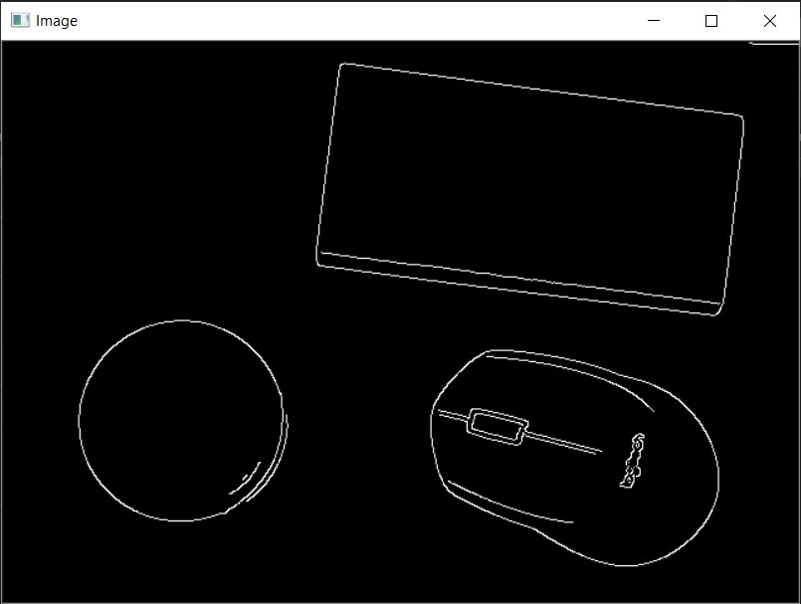
EXPLANATION OF CODE:
edged = cv2.Canny(gray, 50, 100)
This command detects the edges in an image in 3 steps:
Computing intensity gradient of the image
Non-maximum suppression
Hysteresis Thresholding

Slide 9
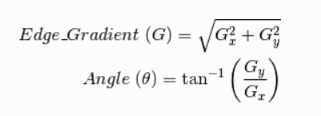
CANNY EDGE DETECTION ALGORITHM
The Canny filter is a multi-stage edge detector.
It computes the intensity of the gradients by using a filter based on the derivative of a Gaussian.
Smoothened image is filtered with a Sobel kernel in both horizontal and vertical direction to get first derivative in horizontal direction (G_{x}) and vertical direction (G_{x}).
The effect of noise present in the image is reduced by the gaussian.
The non-maximum pixels of the gradient magnitude are removed by thinning down the potential edges to 1-pixel curves.
Lastly, the edge pixels are retained or removed through the use of hysteresis thresholding on the gradient magnitude.

Slide 10
CANNY EDGE DETECTION ALGORITHM
The Canny has three adjustable parameters:
The Gaussian width (Greater noise corresponds to a greater width)
The low and high threshold for the hysteresis thresholding.
The criteria for edge detection are:
Detecting edges with a low error rate in order to catch the maximum number of edges in the image.
The edge point detected from the operator should accurately localize on the center of the edge.
A given edge in the image should only be detected once
False edges should not be detected due to noise.

Slide 11
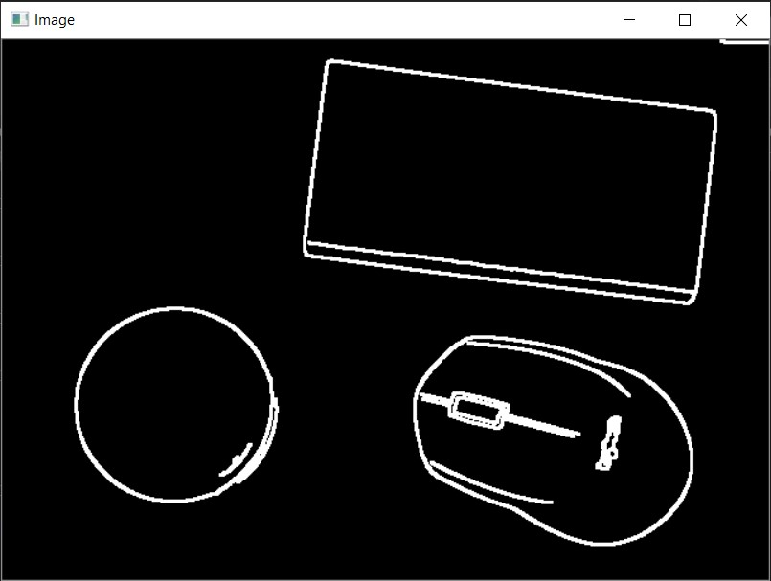
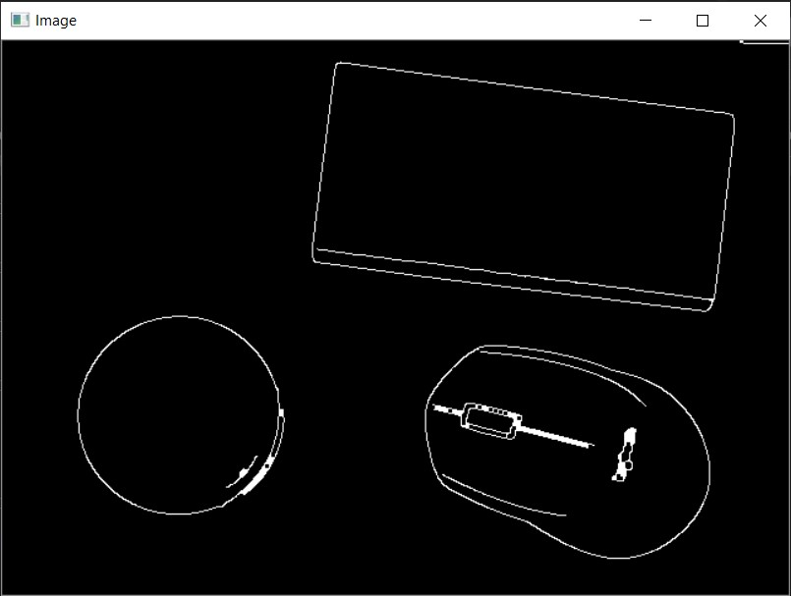
EXPLANATION OF CODE:
edged = cv2.dilate(edged, None, iterations=1)
This command is used to thicken the edges and close any gaps that were formed while performing edge detection.
edged = cv2.erode(edged, None, iterations=1)
This command is used to make the edges thinner for more precise results.

Slide 12
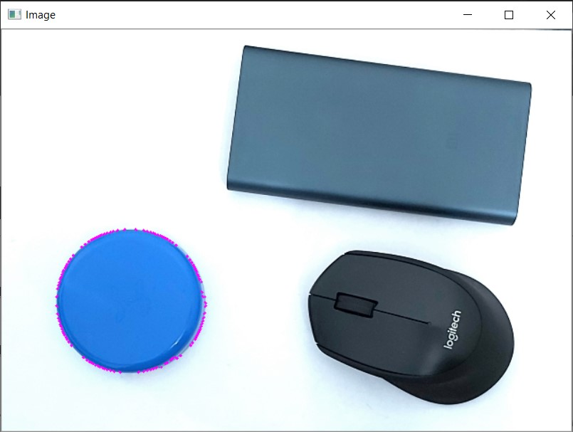
EXPLANATION OF CODE:
cnts = cv2.findContours(edged.copy(), cv2.RETR_EXTERNAL, cv2.CHAIN_APPROX_SIMPLE)
cnts = imutils.grab_contours(cnts)
Contours are defined as the line joining all the points along the boundary of an image that are having the same intensity. The first command finds the coordinates of the contours in the image and stores them in an object.
The second command parses the lists of the coordinates from the object.

Slide 13
EXPLANATION OF CODE:
box = cv2.minAreaRect(c)
This command finds the coordinates of a box that envelopes one set of contours such that the area outside the contours is minimized.
(tl, tr, br, bl) = box
(tltrX, tltrY) = midpoint(tl, tr)
(blbrX, blbrY) = midpoint(bl, br)
(tlblX, tlblY) = midpoint(tl, bl)
(trbrX, trbrY) = midpoint(tr, br)
These commands compute the midpoints of the edges of the box.

Slide 14
EXPLANATION OF CODE:
dA = dist.euclidean((tltrX, tltrY), (blbrX, blbrY))
dB = dist.euclidean((tlblX, tlblY), (trbrX, trbrY))
These commands compute the Euclidean distances between pairs of opposite midpoints.
pixelsPerMetric = dB / args["width“]
dimA = dA / pixelsPerMetric
dimB = dB / pixelsPerMetric
The first command computes the pixels per metric ratio using the Euclidean width of the object in pixels and the width of the left most object in inches input by the user.
The next two lines compute the dimensions of the object in inches using the PPI ratio and the Euclidean dimensions in pixels.

Slide 15
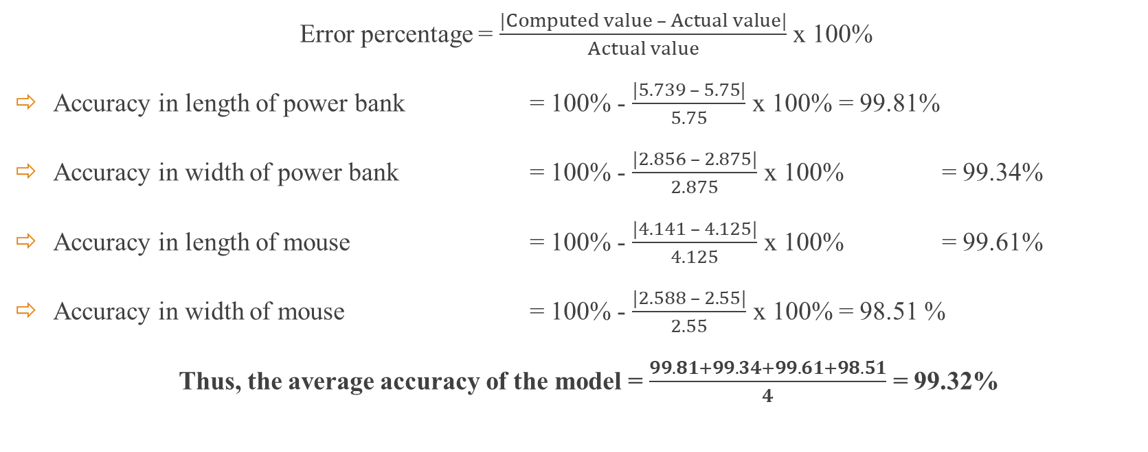
ACCURACY
Error percentage = $\frac{|Computed value – Actual value|}{Actual value}$ x 100%
Accuracy in length of power bank = 100% - $\frac{|5.739 – 5.75|}{5.75}$ x 100% = 99.81%
Accuracy in width of power bank = 100% - $\frac{|2.856 – 2.875|}{2.875}$ x 100% = 99.34%
Accuracy in length of mouse = 100% - $\frac{|4.141 – 4.125|}{4.125}$ x 100% = 99.61%
Accuracy in width of mouse = 100% - $\frac{|2.588 – 2.55|}{2.55}$ x 100% = 98.51 %
Thus, the average accuracy of the model = $\frac{99.81+99.34+99.61+98.51}{4}$ = 99.32%

Slide 16

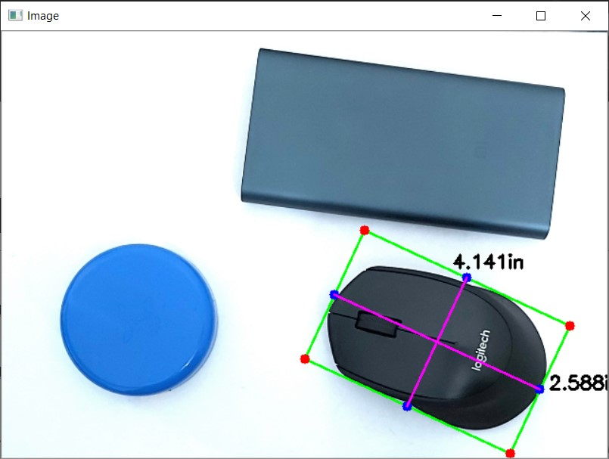

OUTPUT SCREENSHOTS:

